Slide 1

Brand Playbook
Crafting Preferred Engineers
Last updated: August 2026

Slide 2
Brand Playbook
Introduction
Engineering excellence.
Building a better tomorrow.
At Orena Solutions, we exist to craft preferred engineers — people and organizations built for a future they helped design. We connect quality, people, and sustainability into every engagement we deliver.
This playbook explains how to give things the Orena touch. Use it to understand our visual identity and voice, so that everything we create feels connected and consistent.
ORENA SOLUTIONS — BRAND PLAYBOOK

Slide 3
Contents
About
Colors
Typography
What is Orena
Core Palette
Typefaces
Purpose & Values
Proportions & Usage
Hierarchy
Brand Voice
Logo & Symbol
Visual Devices
Logo
Iconography & Shapes
Symbol
Buttons & UI
Guidelines
Applications
ORENA SOLUTIONS — BRAND PLAYBOOK

Slide 4
Orena Solutions
Brand Playbook
About Orena
What customers know and trust us for.
ORENA SOLUTIONS — BRAND PLAYBOOK

Slide 5



About Orena
What is Orena
Crafting Preferred
Engineers.
Quality
Committed to the highest standards in everything we do.
People
Empowering minds and building futures.
Orena Solutions builds the pipeline between raw engineering talent and the organizations who need it most — hiring, training and culture transformation, delivered as one connected system. We are part of the Shakti Ecosystem, engineering solutions that respect people and planet alike.
Sustainability
Engineering solutions that respect our planet.
ORENA SOLUTIONS — BRAND PLAYBOOK

Slide 6
About Orena
Purpose
Power the pipeline of
preferred engineers.
We're the engine that connects hiring, training and culture transformation into one system.
Tailored solutions for organizations who want engineering talent built for tomorrow, not just today.
Without friction or complexity. Quality, people and sustainability, in equal measure.
ORENA SOLUTIONS — BRAND PLAYBOOK

Slide 7
About Orena
Brand Voice
Reliable
We deliver on our word. Every engagement is built on consistency organizations can plan around.
Forward-thinking
We anticipate where talent and industry are headed, not just where they are today.
People-focused
Every solution starts with the humans it serves — engineers, teams and leaders alike.
Impact-driven
We engineer solutions that create lasting value, not just short-term output.
ORENA SOLUTIONS — BRAND PLAYBOOK

Slide 8
Orena Solutions
Brand Playbook
Colors
How we use color to denote our brand and signpost information.
ORENA SOLUTIONS — BRAND PLAYBOOK

Slide 9
Colors
Core Palette
Our colors reflect the reliability, growth, and human focus of Orena — grounded in green, framed in soft neutrals, and lifted with a touch of lime.
Orena Green
Mist Green
#0D7043 · Primary / Headings · ~60%
#D7E9DF · Borders / Subtle Dividers · ~20%
Emerald
Deep Forest
#00AF63 · Buttons / CTAs / Links · ~20%
#0F5B37 · Dark Backgrounds / Footer · ~5%
Fresh Leaf
Charcoal
#48B855 · Accents / Icons / Charts · ~10%
#18231E · Body Text / Primary Text · ~90%
Lime Spark
Muted Green Grey
#B5D60C · Highlights / Call-outs · ~5%
#66756D · Secondary Text / Icons · ~10%
Pale Mint
Warm White
#E8F4EE · Backgrounds / Panels · ~60%
#FAFCF9 · Main Canvas · ~100%
ORENA SOLUTIONS — BRAND PLAYBOOK

Slide 10
Colors
Proportions & Usage
We use a lot of negative space and soft neutrals to keep layouts calm and legible. Orena Green is used sparingly to draw attention to headlines and core actions. Lime marks only the most important highlights.
Warm White
Base canvas for pages and documents
Pale Mint
Frames content and breaks up sections
Orena Green
Headlines, typography and icons
Lime Spark
Buttons & highlights
ORENA SOLUTIONS — BRAND PLAYBOOK

Slide 11
Orena Solutions
Brand Playbook
Logo & Symbol
Variations, do's and don'ts.
ORENA SOLUTIONS — BRAND PLAYBOOK

Slide 12
Logo & Symbol
Logo
The primary visual of the Orena identity.
Always use with adequate white space around the mark, as indicated by the guides.
ORENA SOLUTIONS — BRAND PLAYBOOK

Slide 13

Logo & Symbol
Symbol
For compact use — avatars, favicons, or where space is limited.
Provide sufficient white space. Always shown within an app-icon shape.
ORENA SOLUTIONS — BRAND PLAYBOOK

Slide 14
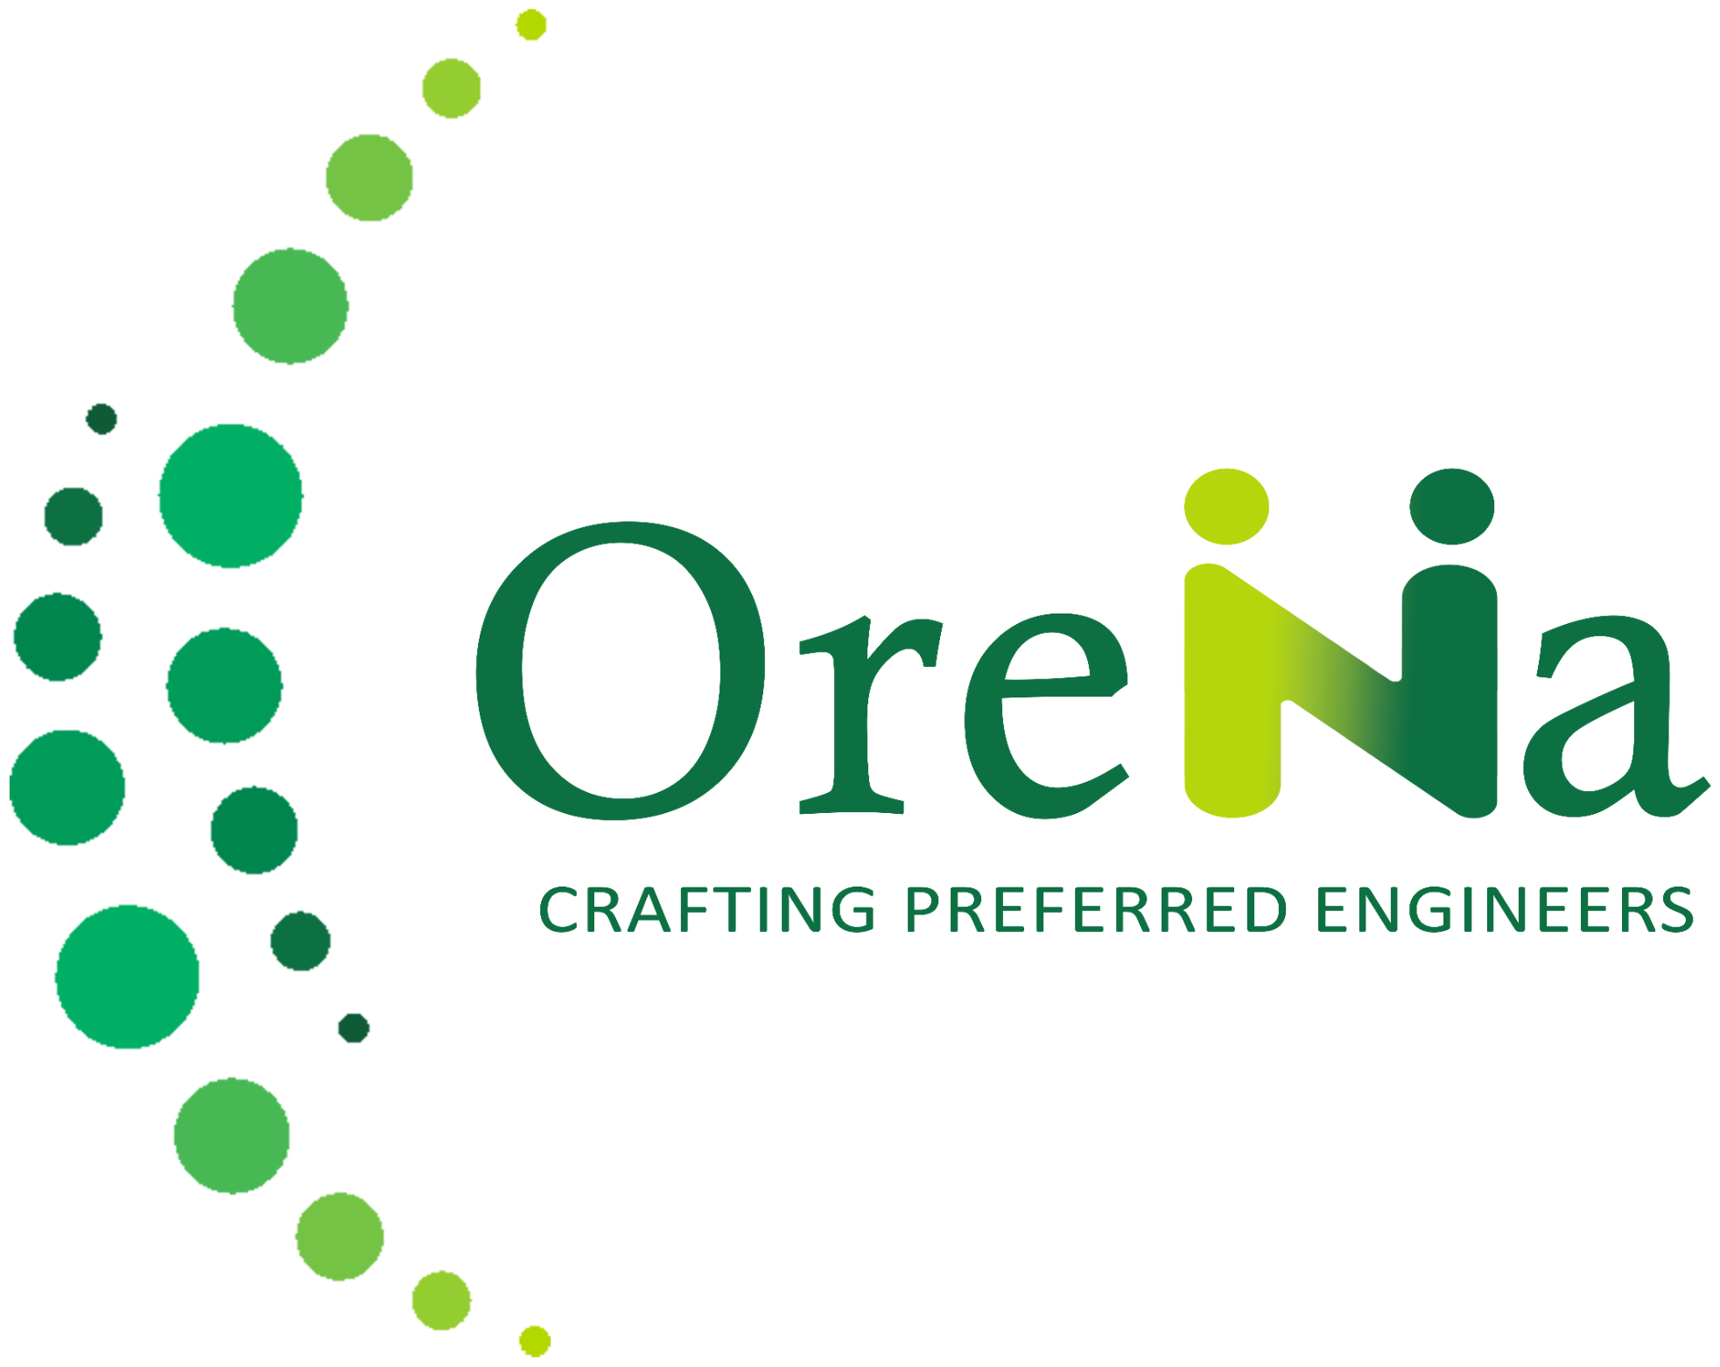
Logo & Symbol
General Guidelines
Our logo is our identity and should be treated with respect. It can be used in Orena Green or white.
If the background is light, use the full-color mark. If the background is dark, use the logo in white.
The don'ts
Don't recolor it. Don't add a gradient.
Don't stretch it. Don't add a stroke.
Don't place it on low-contrast backgrounds.
ORENA SOLUTIONS — BRAND PLAYBOOK

Slide 15
Orena Solutions
Brand Playbook
Typography
The type system that makes our communication feel effortless.
ORENA SOLUTIONS — BRAND PLAYBOOK

Slide 16
Typography
Typefaces
Our primary typeface is Poppins, a geometric sans that feels modern and confident.
Poppins
Document titles & section headers — Bold / Semi Bold, Orena Green
Crafting Preferred Engineers
Inter is our secondary typeface, used for body copy, labels and UI text.
Inter
Body text & captions — Regular, Charcoal / Muted Green Grey
Engineering excellence. Building a better tomorrow.
Captions & labels
ORENA SOLUTIONS — BRAND PLAYBOOK

Slide 17
Typography
Hierarchy
Whenever we write and design with copy, please follow these hierarchy principles.
Document Titles
Crafting Preferred Engineers
40pt Bold · Poppins · Orena Green
Section Headers
Purpose & Values
24pt Semi Bold · Poppins · Orena Green
Body Text
We engineer solutions that create lasting value for people and organizations alike.
16pt Regular · Inter · Charcoal
Captions & Labels
Engineering excellence, building a better tomorrow.
12pt Regular · Inter · Muted Green Grey
ORENA SOLUTIONS — BRAND PLAYBOOK

Slide 18
Orena Solutions
Brand Playbook
Visual Devices
How we add craft and clarity to our brand.
ORENA SOLUTIONS — BRAND PLAYBOOK

Slide 19









Visual Devices
Iconography & Shapes
A consistent line-and-form icon set covers our core themes — quality, growth and connection.
Quality
Teamwork
Strategy
Growth
Excellence
Learning
Solutions
Partnership
Global
Half-circle motifs and dot clusters echo the mark across backgrounds and dividers.
ORENA SOLUTIONS — BRAND PLAYBOOK

Slide 20




Visual Devices
Buttons, UI & Elements
BUTTON STYLES
UI ELEMENTS
NUMBER BADGES
Primary Button
Checkbox
01
02
03
Radio Button
Secondary Button
DO'S
Toggle
✓ Use green for authority & trust
Tertiary Button
Text Input
✓ Keep layouts clean & spacious
✓ Highlight with lime sparingly
BADGES & TAGS
Dropdown ▾
✓ Maintain strong contrast
DON'TS
Progress — 60%
✕ Don't overuse lime
Engineering
✕ Don't crowd the layout
✕ Don't use low-contrast text
Innovation
Sustainability
ORENA SOLUTIONS — BRAND PLAYBOOK

Slide 21

Visual Devices
Application Examples
How the identity comes together across real touchpoints — from business cards to social profiles.
John Doe
Senior Engineer
john.doe@orena.com
+91 98765 43210
SOCIAL & APP ICON
DOCUMENT COVER
SLIDE TEMPLATE
Crafting Preferred Engineers
Preferred
Engineers
Playbook
ORENA SOLUTIONS — BRAND PLAYBOOK

Slide 22
Thank you.
Queries? Contact us at hello@orenasolutions.com

